Slide 1
Choosing Where to live
Capstone Project Report: The Battle of Neighborhoods

Slide 2
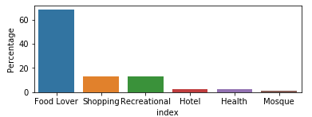
Problem Statement
There is a person who want to live/ stay in a city. And want to choose which city it should choose and then in that city where one should go depending upon ones liking. Either one wants to choose a region to stay where there is a lot of food option (Food Lover). Or one is recreational and want to enjoy the scenery or have fun.

Slide 3
Data Description
First geopy will be used to find the location (latitude and longitude) of the cities.
Then using FOURSQAURE Credentials we will get the venues near those cities.
We will categorize the venues in six.
We will compare the categories of the cities
We will define the region using kmeans clustering.
Then one can choose the region based on ones priorities.

Slide 4
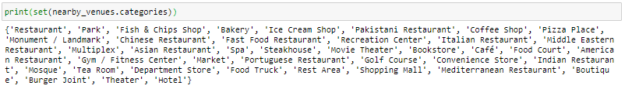
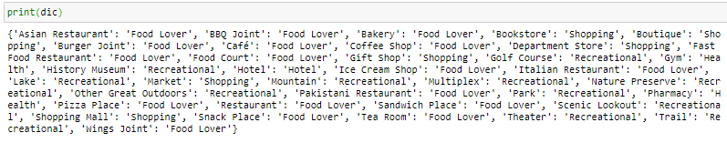
Methodology
We had different categories.
We EDA using dictionary to make a new category ‘New Cat’.
Used kmeans Unsupervised Clustering Algorithm to make regions

Slide 5
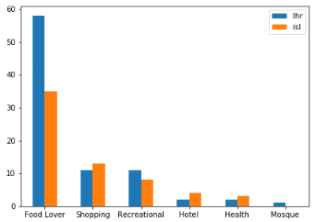
Results
Lahore has more Food Lover Spots than Islamabad (As per FourSquare App)
Lahore has more Recreational Spots than Islamabad
Islamabad is better in hoteling and Health
Lahore and Islamabad are almost equal for Shopping

Slide 6
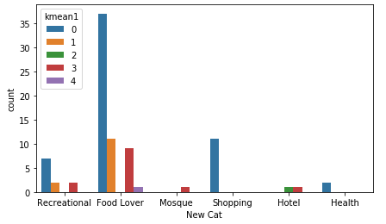
RESULTS Insights from LAHORE Data
If you are food lover, you may choose to stay in Cluster 0.
If you are recreational you may choose Cluster 0.
If you love shopping, you may choose Cluster 0.
If you are health conscious then you may choose 0.
If you want to stay in hotel you have to go to cluster 2 or 3.

Slide 7
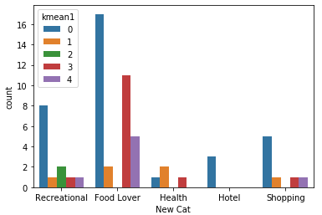
RESULTS Insights from ISLAMABAD Data
If you are food lover, you may choose to stay in Cluster 0 or 3.
If you are recreational you may choose Cluster 0.
If you love shopping, you may choose Cluster 0.
If you are health conscious then you may choose 0,1 or 3.
If you want to stay in hotel you have to go to cluster 0.

Slide 8
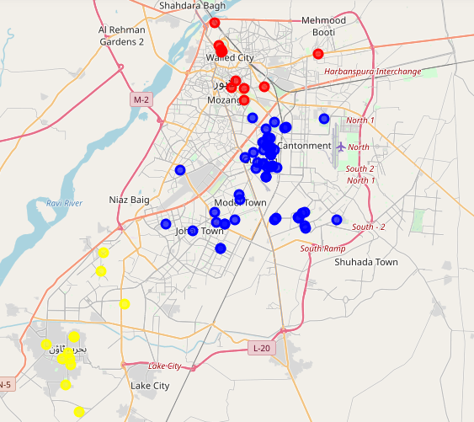
Discussion LahORE AREA SELECTION
One from Lahore should choose to live in BLUE Cluster for having access to various Categories.

Slide 9
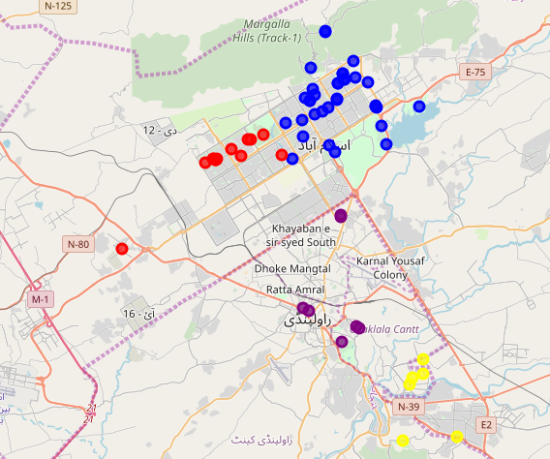
Discussion ISLAMABAD AREA SELECTION
One from ISLAMABAD should choose to live in BLUE Cluster for having access to various Categories.

Slide 10
Conclusion
The both cities are almost equal as per FourSquare data in categories defined.
Through Clustering the excess of nearby spots are shown in blue. Which makes the blue cluster most feasible for multiple category types.
However, a person can choose the cluster depending upon its favorite type of category through figure 11 and 12.

